Slide 1

Restaurant Reservation System
Abdullah Can Algan
Damla Dinçer
Gizem Gülşah Koçak

Slide 2
Project Outline
Introduction
What were our purposes ?
What do we do? / or not?
Sequence Diagram
Technologies
Project Database
Extra Properties
Test
Conclusion
References

Slide 3
Introduction
In this software project , we aimed to create a web based restaurant booking system by using Agile software development pricinples.
At the beginning of the project, we did Sprint Plan
And try to adopt it as much as we can.

Slide 4
What were our purposes?
Register / Login ability to the system for users
Searching for restauran
Making a reservation
Choosing menu
Profile for users to see their reservation list / Cancel reservation
Restaurant owner can see the reservations

Slide 5
What do we do?
Customer Register/ Login to the system
Restaurant Search
Make a Reservation / Cancel Reservation
Choosing a menu

Slide 6
Can not?
All reservation list can be seen by restaurant owner. We could not perform this user story.
Choosing a menu function is not implemented as we were planning. We were going to add this functionality as a seperate page. Instead of this, we made it extra option in the reservation form because of technical difficulties.

Slide 7
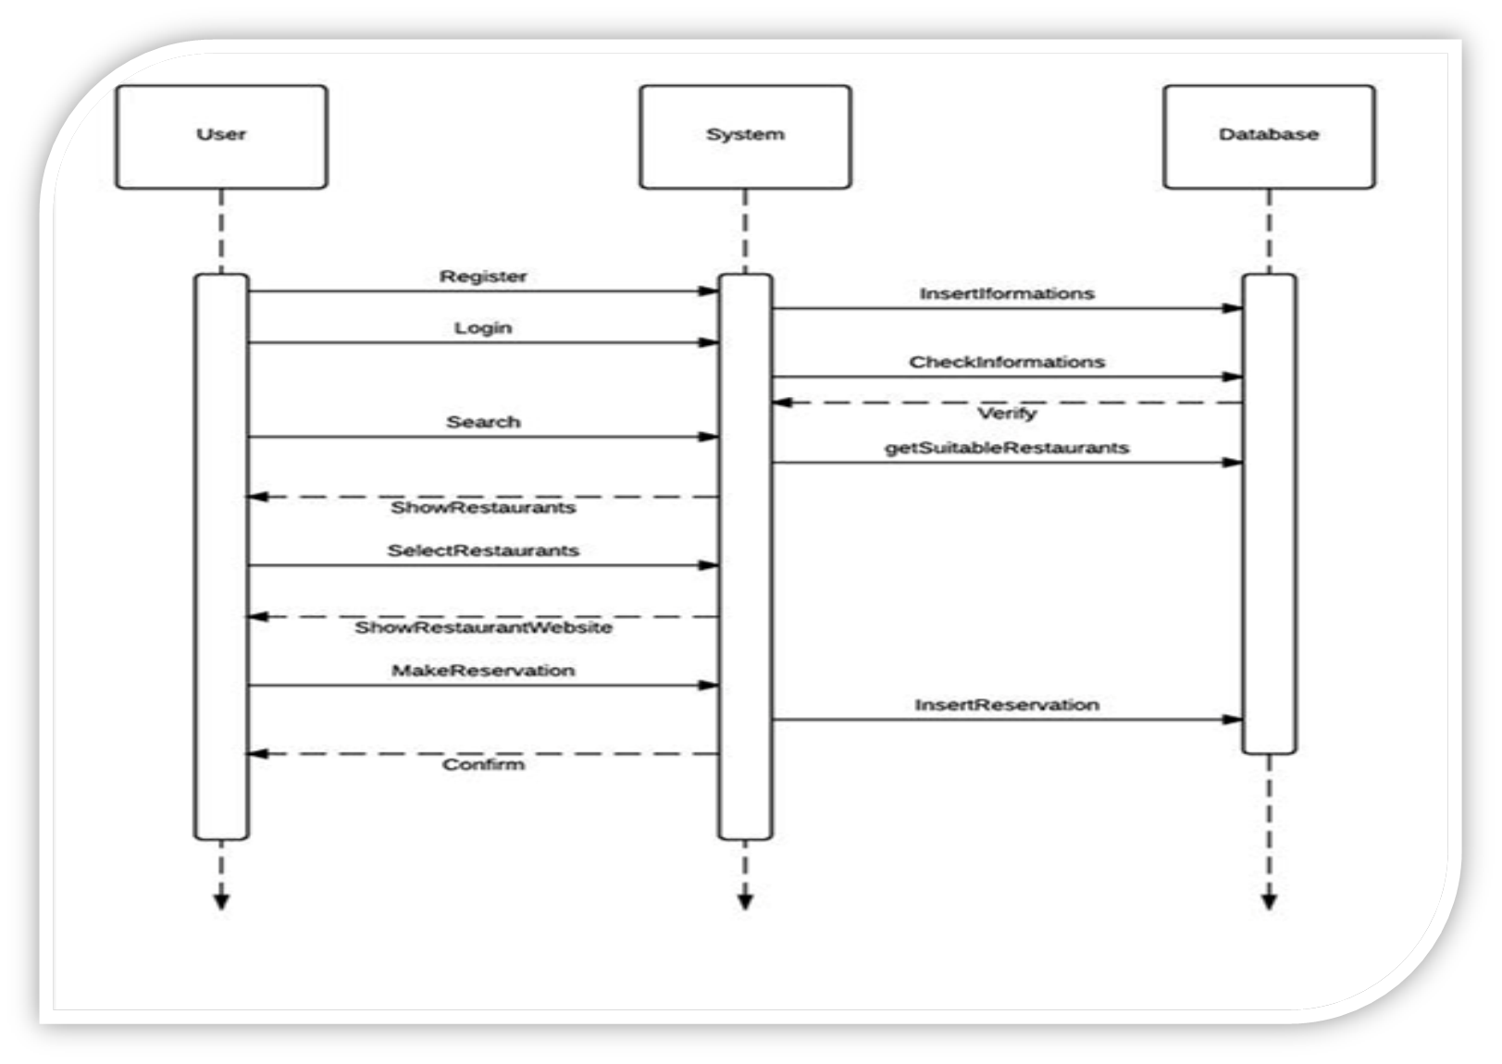
Sequence Diagram

Slide 8
Technologies & Tools
PHP – HTML - CSS: Sublime text 2
PHPUnit Test: Netbeans
JavaScript: Pages have clocks and dates in the upper right corner
Google Maps API: Restaurant pages has a map that shows the location

Slide 9
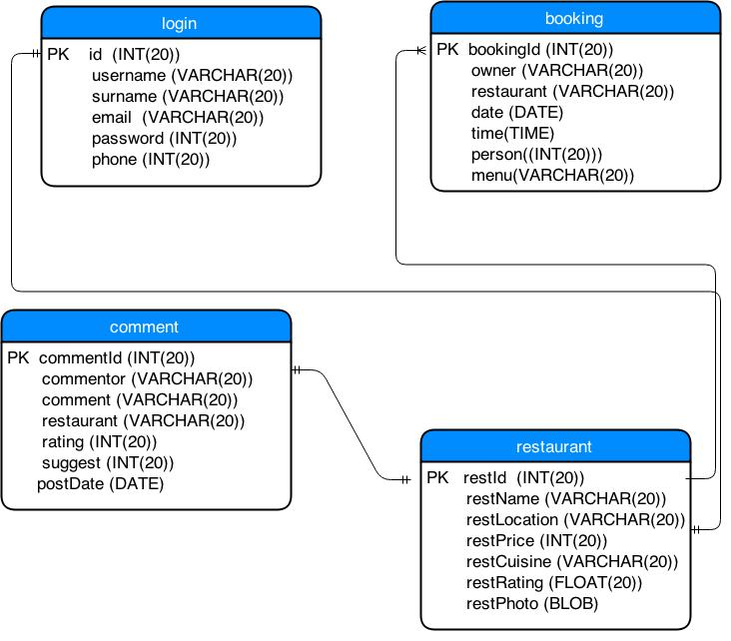
Project Database

Slide 10
Extra Properties
Display date and time in the right upper corner
Rating andCommenting System for the restaurants
  Users can make a comment to express their feelings about restaurants
Category page to display restaurants in the ordered lists
  Most popular, Cheapest ...
.

Slide 11
Testing
PHPUnit test was used for testing.
Testing enviroment is NetBeans with PHPUnit plugin

Slide 12
Conclusion
Positive sides:
We implemented almost all of our goals
We tracked the sprint plan
Negative sides:
We could make a better plan at first
We have changed our development tools many times because we experience many technical problems.

Slide 13
References
Google API: https://developers.google.com/maps/web/
PHPUnit: https://phpunit.de/getting-started.html

